Slide 1
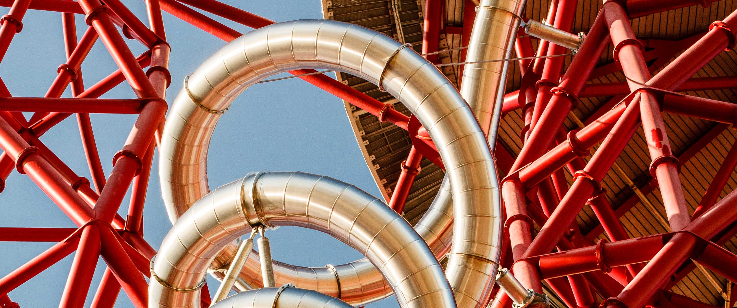
Notes:
(

Slide 2
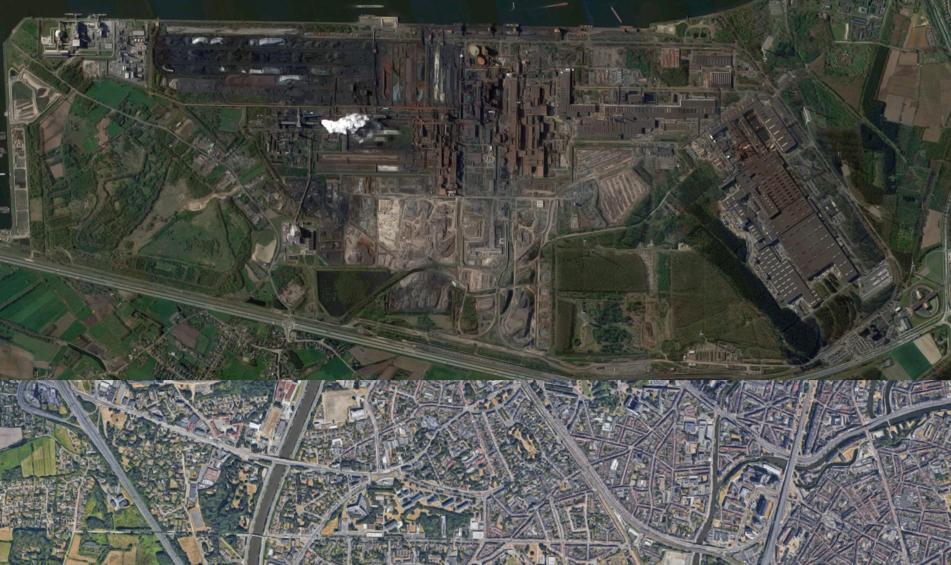

Slide 3
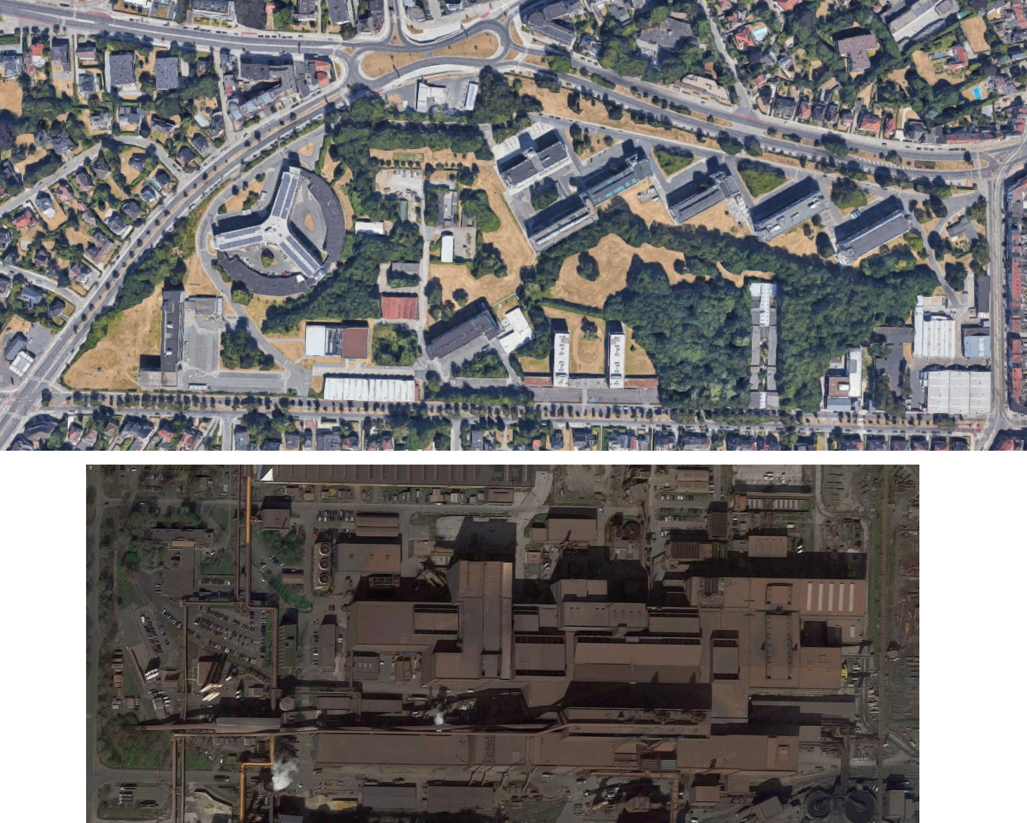

Slide 4
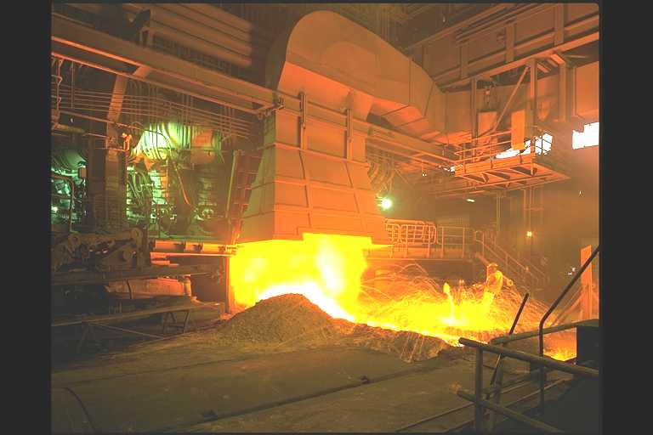
Blast furnaces
Cast floor
Notes:
Hier staat iemand!

Slide 5
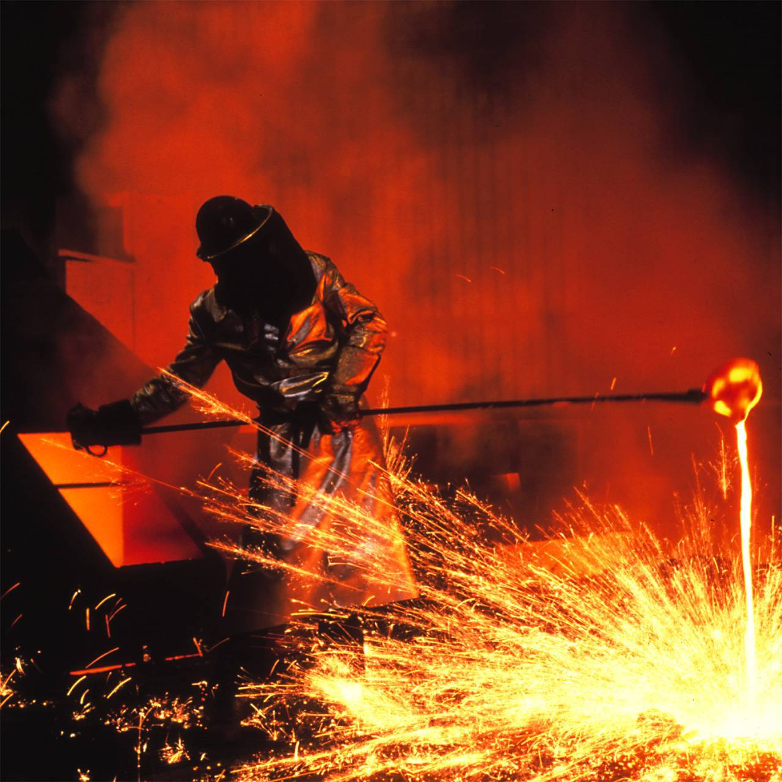
Blast furnaces
Sampling of pig iron

Slide 6
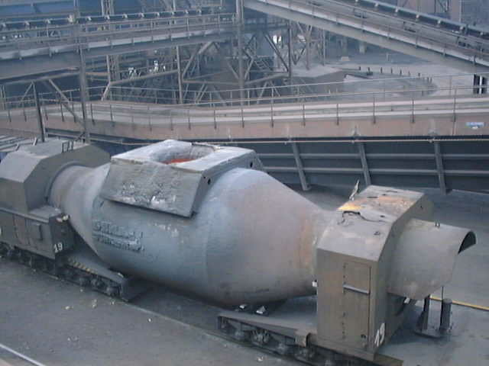
Transport of pig iron
Torpedos

Slide 7
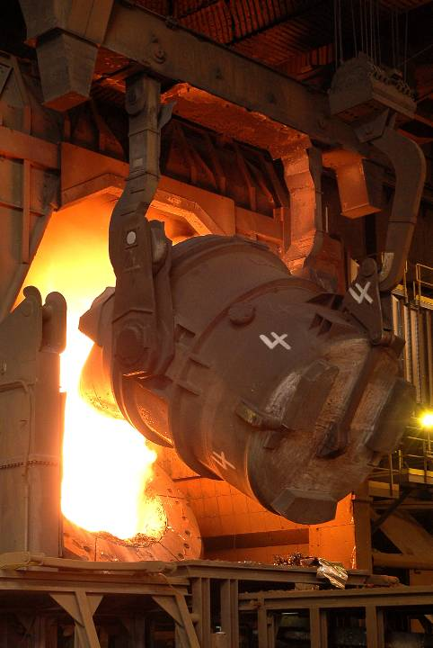
Steel mill loading hot metal into the convertor
Notes:
Ijzer → staal: koolstof verwijderen door inblazen zuurstof

Slide 8
People everywhere
Lots of expertise, on all levels, operators, metallurgists, modelling specialists, software engineers, ...
Every detail comes with 10 subdetails, every data point has a story
Constantly new ideas, tests, improvements, revamps, ... going on

Slide 9
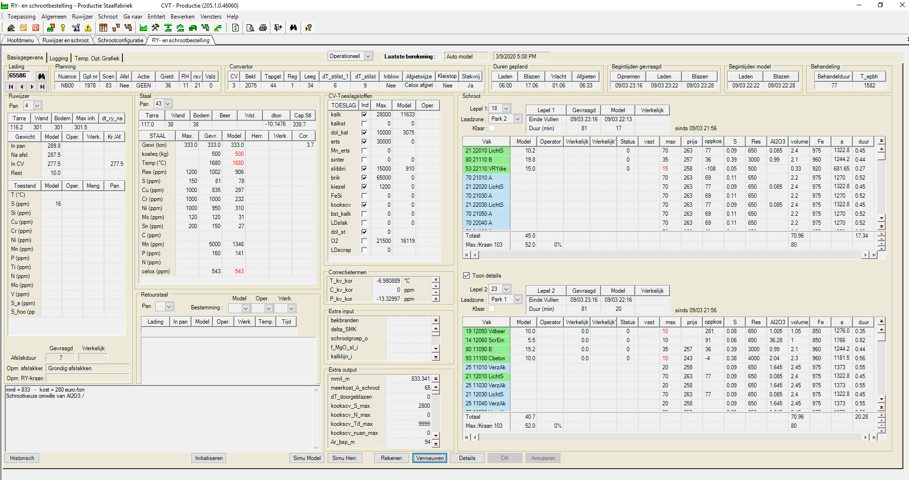
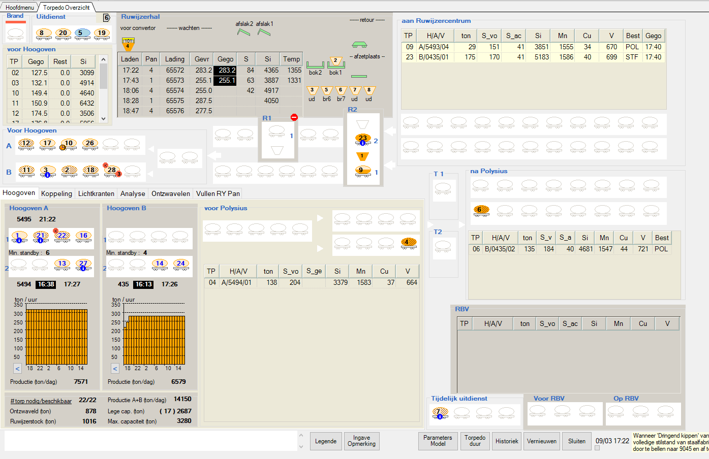
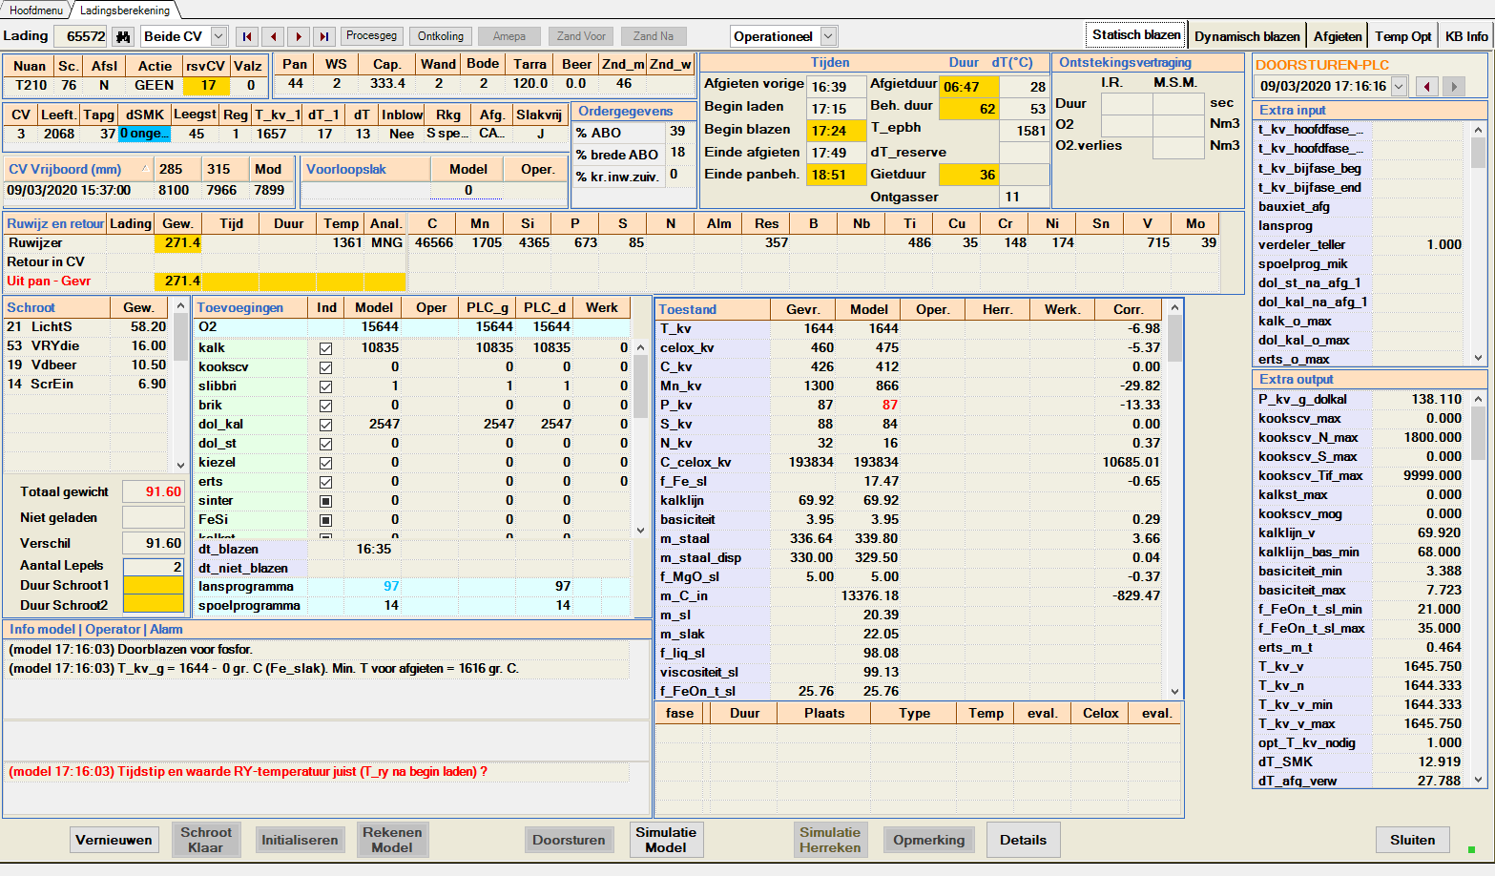
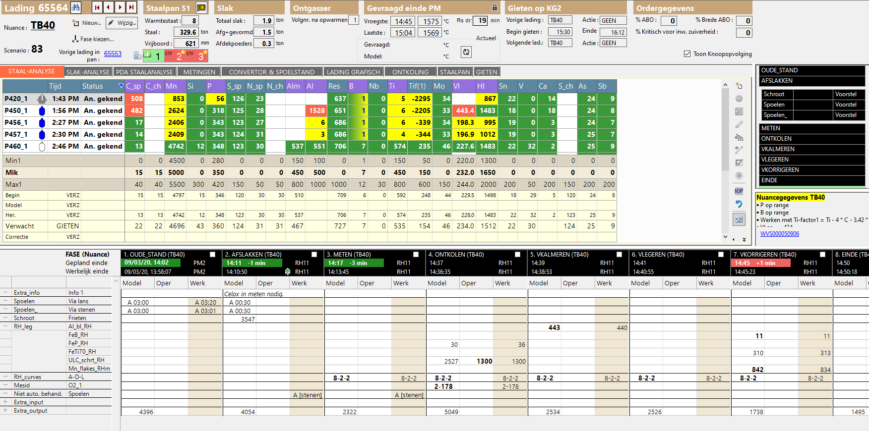

Slide 10
