Slide 1
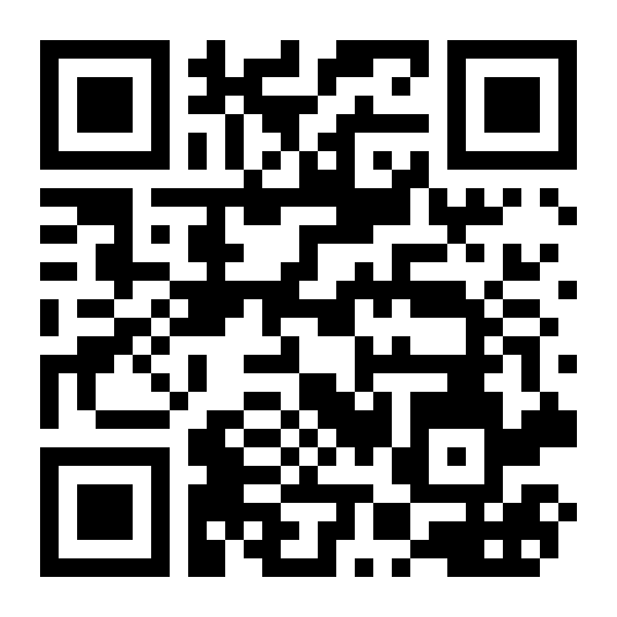
Aart Kuijken Team Leader R&D Barco NV
Master in Computer Science – Ugent 1992-1996
Preasidium WINA 1994-1995 (Feest/Hofnar)
Career path
Nimble NV/Objective NV
Software development
TeleAtlas NV/TomTom NV
Software development
Agile roles (scrum master, product owner, agile coach, scaled agile)
Team lead
Barco NV
Agile roles
Team lead
VISIT US AND TALK ABOUT YOUR CAREER!
March 16 and March 27, @Barco Kortrijk
Registration: lore.vandevyvere@barco.com

